Slide 1





Customer Demographics Study & Analysis
An end-to-end analytics workflow evaluating customer behavior, income patterns, spending scores, and product preferences.

Slide 2






Analytics Project Workflow
1. Data Cleaning
2. SQL Analysis
3. Power BI Dashboard
Inspected raw records with Pandas. Executed null checks, duplicate row removals, column standardizations, and data type verifications.
Imported cleaned datasets into SQL Server. Formulated targeted queries using aggregations, CASE age groupings, and ranking logic.
Designed interactive visualizations, established custom DAX measures, and configured demographic slicers for executive reporting.

Slide 3
Dataset Schema & Variables
Field Name | Type / Category | Analytical Purpose
id | Identifier | Unique customer identifier used for distinct counting
age | Demographic Metric | Customer age, segmented into 5 logical age cohorts
gender | Demographic Attribute | Gender breakdown (Male, Female, Other) for income study
income | Financial Metric | Annual income evaluation across demographic groups
spending_score | Behavioral Index | Customer engagement & spending pattern indicator
preferred_category | Preference Categorical | Product interest (Electronics, Clothing, Sports, etc.)

Slide 4
Data Preparation Protocol
Null & Missing Value Validation: Rigorous inspection confirmed zero null or missing values across all demographic attributes.
Duplicate Row Elimination: Scanned primary keys and full row combinations; verified no duplicate entries existed.
Schema Standardization: Standardized column names to lowercase snake_case and assigned exact numeric and string data types.
Categorical Consistency Audit: Standardized category values across gender classifications and product preference strings.
Database Export: Exported validated dataset from Pandas environment directly to SQL Server database tables.

Slide 5
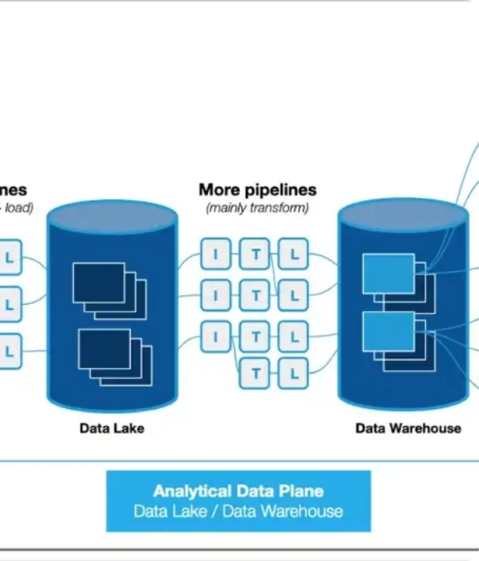
SQL Querying & Analysis
SQL Server Logic Highlights
SQL Server was utilized to answer business questions regarding average metrics, age-group comparisons, and top category preferences.
Applied TOP 1 filtering for single-winner queries (e.g., age group with highest income) and CASE statements to construct dynamic age brackets (15-25, 26-35, 36-45, 46-55, 56+).

Slide 6

Core Portfolio Scale
DAX Measure Formulation
1,000
Key performance metrics were established in Power BI using custom DAX formulas to enable dynamic calculation across slicer selections:
• Total Customers: DISTINCTCOUNT(customer_data[id])
Cleaned Customer Profiles
• Avg Income: AVERAGE(customer_data[income])
• Avg Spending Score: AVERAGE(customer_data[spending_score])

Slide 7
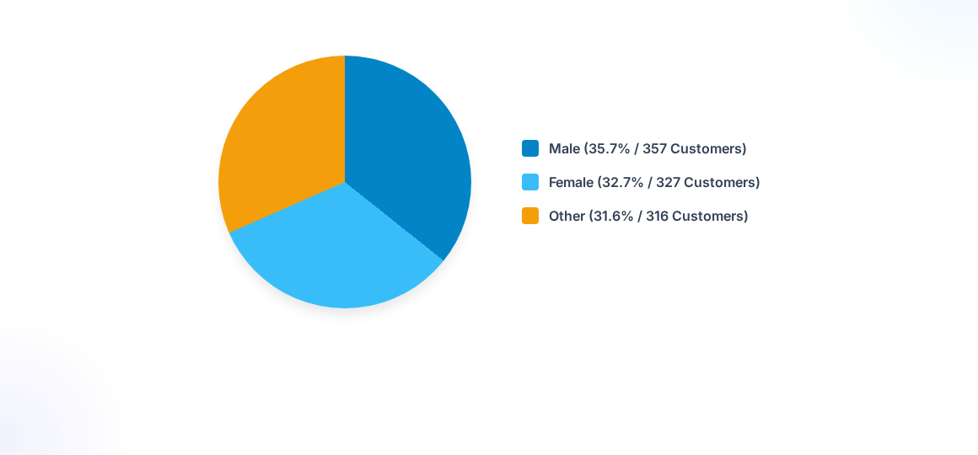
Gender Composition
The customer base displays a balanced tri-gender distribution, ensuring demographic analysis is representative across all major customer segments.

Slide 8
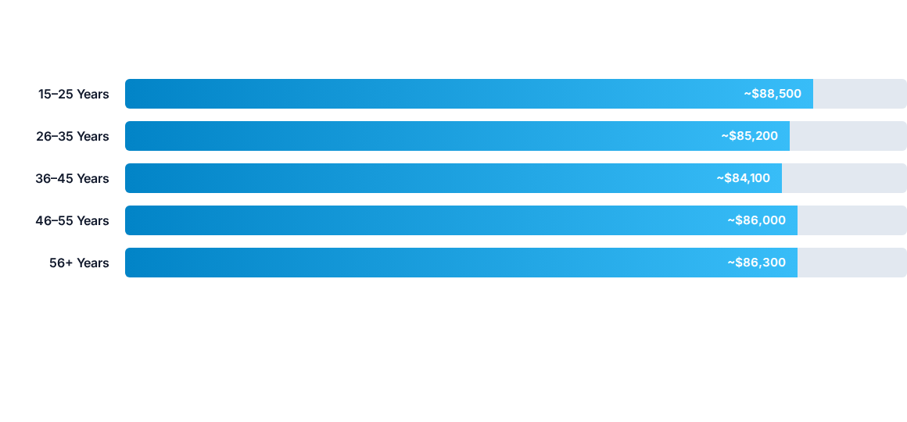
Income by Age Cohort
Average income remains relatively steady across all age brackets (~$84k–$88k), indicating purchasing power parity across age cohorts.

Slide 9

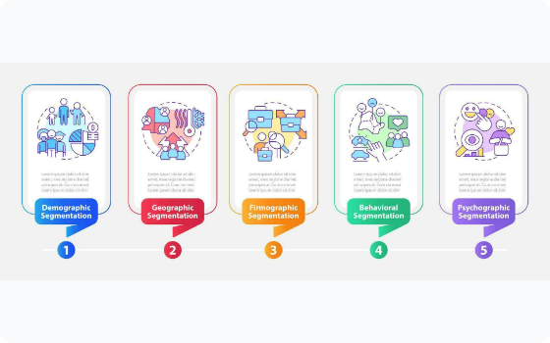
Income vs Spending Score
Key Behavior Finding
Analysis reveals that high income does not directly translate to a higher spending score.
The scatter distribution demonstrates that high-spending behavior occurs across all income tiers. Targeted marketing should decouple spending score targets from pure income thresholds.

Slide 10


Power BI Dashboard Setup
Interactive Slicers
Custom Sorting Logic
Configured dynamic page slicers for Gender, Age Group, and Preferred Category.
Constructed a dedicated numeric sort index column in Power BI for age brackets.
Allows cross-filtering across all visual charts simultaneously for deep-dive customer segment exploration.
Prevents default alphabetical sorting and enforces chronological sequence (15-25, 26-35, 36-45, 46-55, 56+).

Slide 11



Key Strategic Takeaways
Behavioral Targeting
Category Alignment
Future Cohort Scaling
Prioritize spending scores over income metrics when creating customer engagement and loyalty campaign segments.
Tailor product recommendations based on age cohort category preferences (e.g., Groceries, Electronics, Sports, Home).
Lays groundwork for future advanced SQL modeling, including CTEs, Window functions, and true Customer Lifetime Value (CLV).

